Slide 1
School of Geography and Geology
McMaster University
Advanced Topics in Spatial Statistics
Session 18
Area Data IIII

Slide 2
This session
Spatial Models
The role of theory
  Predictive models
  Explanatory models
Example
  Accessibility in Eastern Asia

Slide 3
Spatial Models
Prediction
  Geostatistical models
  Spatial interpolation
Accurate forecasts or predictions (pragmatic approach)

Slide 4
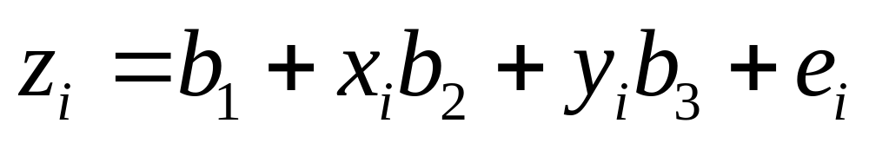
Spatial Models
Trend surface analysis (linear trend)
The coordinates do not “explain” anything, there is no theory involved

Slide 5
Spatial Models
First order component
  Trend surface analysis (linear trend)
  The coordinates do not “explain” anything, there is no theory involved

Slide 6
Spatial Models
Second order component
  Variogram describes spatial structure, does not explain it

Slide 7
Spatial Models
Explanation
  Statistical models
  Spatial statistical models
  Spatial econometric models
The fundamental question is Why?
Accurate forecasts are desirable, but only if model is able to predict for the right reasons

Slide 8
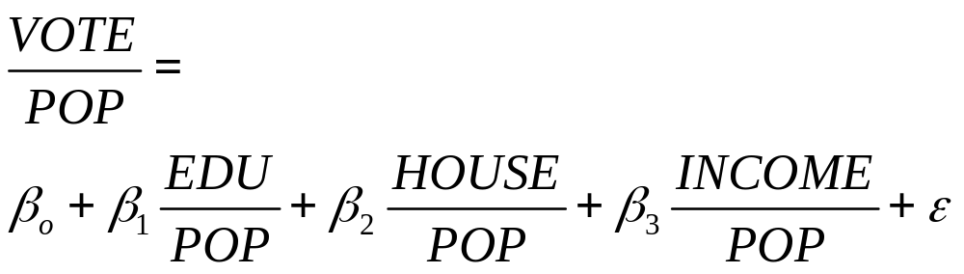
Spatial Models
Statistical models
What is the underlying theory?

Slide 9
The Role of Theory
the·o·ry (thē'ə-rē, thîr'ē)
n., pl. -ries.
  A set of statements or principles devised to explain a group of facts or phenomena.
  Abstract reasoning; speculation.
  A belief or principle that guides action or assists comprehension or judgment.
  An assumption based on limited information or knowledge; a conjecture.

Slide 10
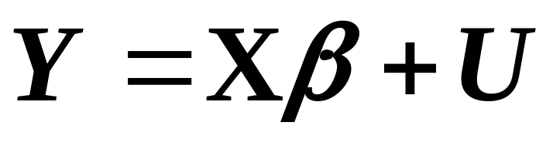

Spatial Models and Theory
(Substantive, not statistical theory)
Autocorrelated errors model
Non-spatial part (needs theory)
May suggest
missing variables
Spatial part (does not need theory)

Slide 11
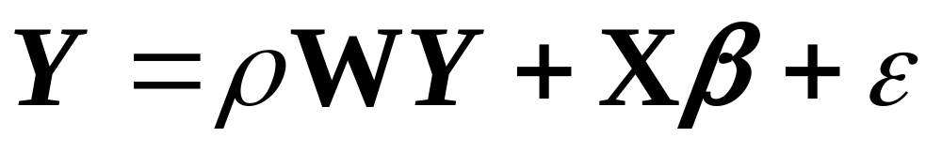
Spatial Models and Theory
Mixed regressive autoregressive
Spatial part
(needs theory)
Non-spatial part
(needs theory)

Slide 12
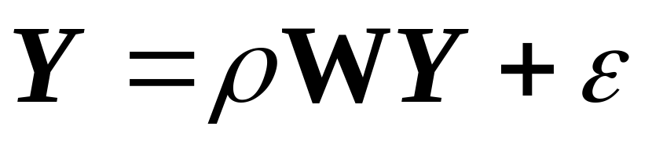
Spatial Models and Theory
Pure autoregressive
Spatial part
(needs theory)

Slide 13
Sources of Theory
Geography
  Spatial interactions theory
Economics
  Public goods
  Economic externalities
  Information spillovers
Sociology
  Social networks

Slide 14
Example
Network accessibility and the distribution of economic activity in Eastern Asia

Slide 15
Accessibility
Definition of accessibility:
“The potential of opportunities for interaction”
(Hansen, 1959)

Slide 16
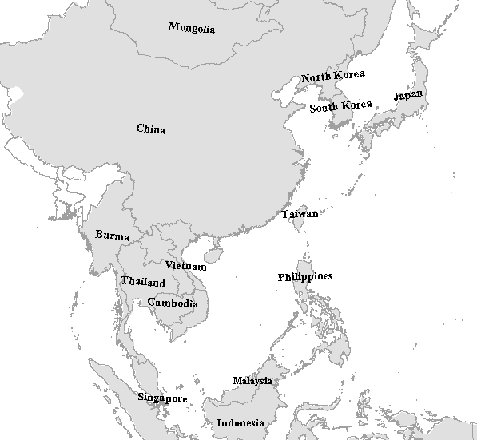
Economic Integration
Northeast Asia Sub-Region
Mekong Economic Zone
The Yellow Sea Sub-region
IMT Growth Triangle
South China Economic Zone
BIMP East ASEAN Growth Area
SIJIORI Economic Zone

Slide 17








Transport-Economic Development Link
Transportation
Services and Infrastructure
Economic
Development

Slide 18
Components of Accessibility
Weight
A measure of how attractive a location is

Slide 19
Components of Accessibility
Impedance
How easy it is to get from here to there
DISTANCE
COST

Slide 20
Accessibility
Simple concept
Clear economic implications

Slide 21
Economic Implications of Accessibility

Slide 22
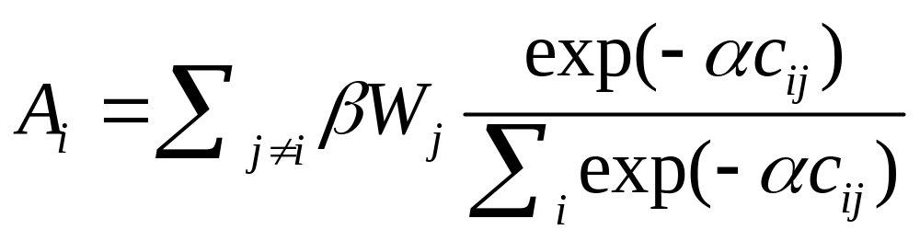
Measuring Accessibility
W_{j} = Local share of GDP, city j
α , β = Parameters
c_{ij} = Generalized travel cost from city i to city j

Slide 23
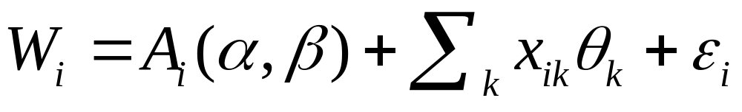
Spatial Model
W_{i} = Local share of GDP, city i
A_{i} = Accessibility of location i
x_{ik} = Explanatory variables
α , β , θ = Parameters

Slide 24
Interpretation of the Accessibility Indicator
β = 0.66
β = 0.50
β = 0.10

Slide 25
Data
17 countries in Eastern Asia
  600+ cities with population > 100,000
  Population
  Local share of GDP (economic output)
Transportation networks
  Road networks
  Main airports and air connections

Slide 26
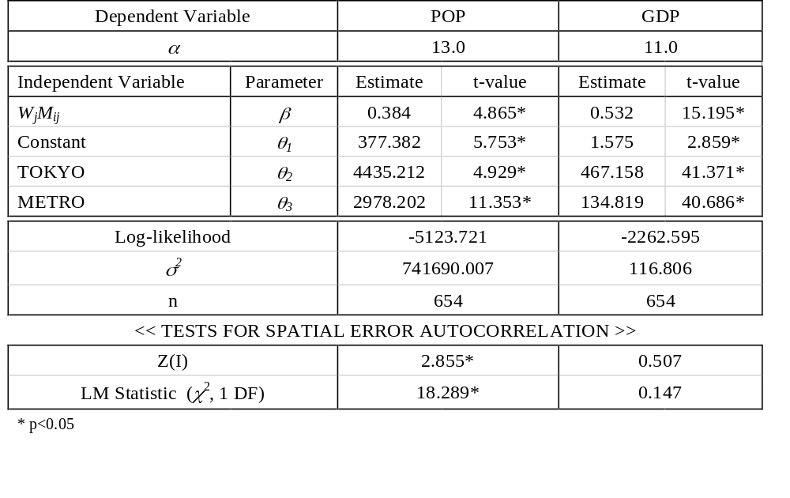
Model Estimation Results

Slide 27
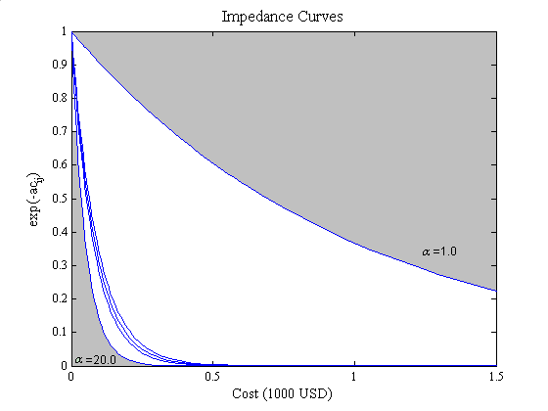
Impedance Curves

Slide 28
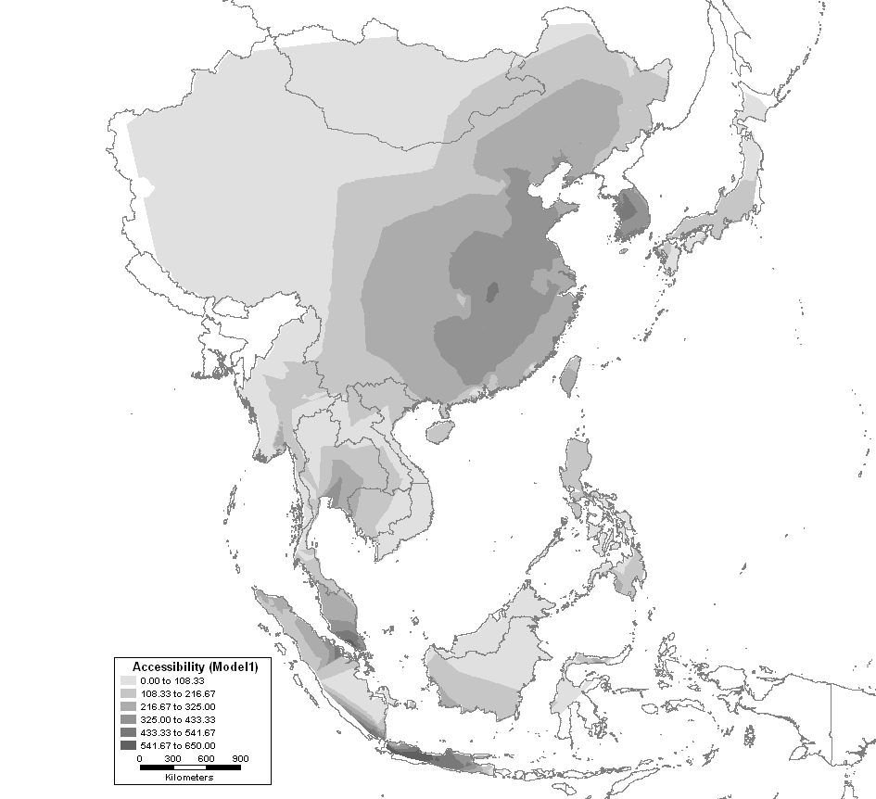
Accessibility to Population

Slide 29
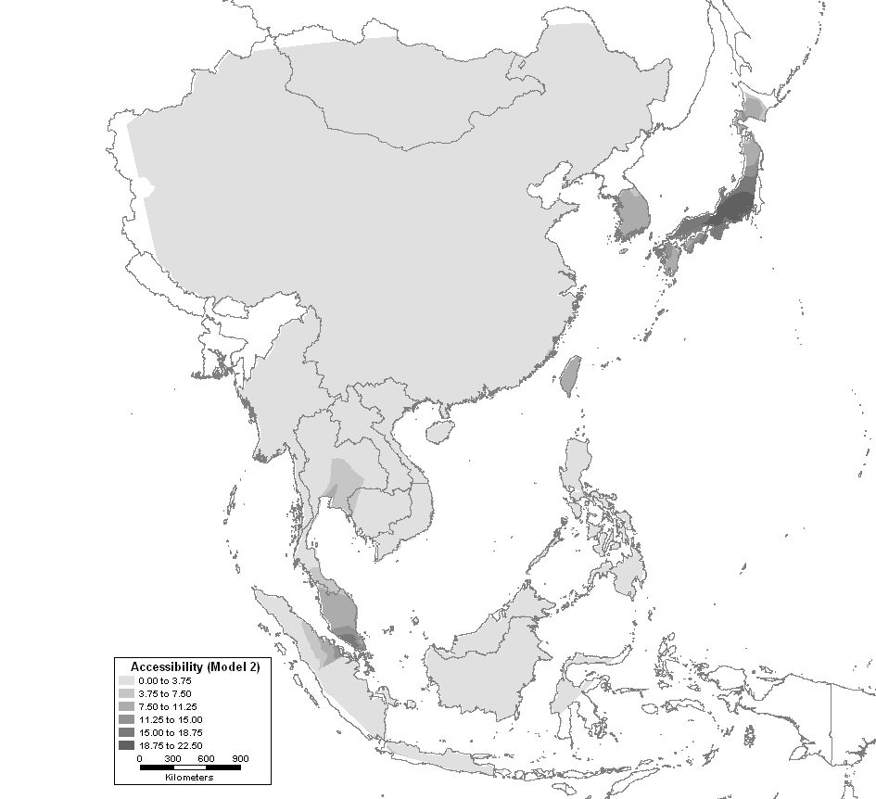
Accessibility to Economic Output

Slide 30
Preliminary Conclusions
Accessibility appears to play a role in explaining the distribution of economic activity in Eastern Asia
Analysis of residuals indicates that there is residual spatial pattern
Multivariate analysis could help to improve the quality of the model

Slide 31
Next…
Final examination
  March 21, in class (2 hours)
  Examination is cumulative
Project presentations
  March 28
  April 4

Slide 32
Example
Sulfur Emissions in Europe
  Sulfur oxides + water vapor + ozone = sulfuric acid
  Acid rain has effects on forests, lakes, rivers, coastal waters and manmade structures
Emission Cutbacks
  United Nations Environmental Programme
  Helsinki Protocol (1985)
Notes:
Why Europe and not North America, for example? Scale: Europe is smaller. Also, political divisions. In North America, it is the US that produces and pays the cost of pollution in most of the region. In Europe,

Slide 33
Economic Instruments
Charge for the use of the environment.
  Useful to encourage environmentally positive behavior and investments.
    Direct alteration of price or cost levels
    Indirect alteration of prices or costs via financial or fiscal means
    Market creation and market support

Slide 34
Economic Instruments
EI’s applied to pollution:
Environment
RESOURCES
Materials levy
Producers:
Production costs
Product design
Marketable permits
Environmental quotas, allowances or ceilings on pollution levels, VOLUNTARY CUTBACKS
Extraction
Transformation
Consumers:
Product choice
Disposal choice
Product Charge
Consumption
Disposal
Deposit-refund systems
Disposal Charges
WASTE
Environment

Slide 35
Example
Sulfur Emissions in Europe
  Unit of analysis: 26 countries
Research question:
  What sort of strategic behavior will be adopted by countries regarding emission cutbacks?
Notes:
What sort of behavior would we expect if all emissions were deposited in the same country?

Slide 36
Data
DSO: Change in sulfur emissions (80-85)
GNP83: Country’s income (GNP)
COST: for reducing emissions
A_{ii}: The fraction of a country’s emissions that falls within its own borders
A: Transport matrix
A·DSO: Reductions in trans-boundary depositions

Slide 37
Econometric Procedure and Data
The theory suggests that data on individual contributions to emission reductions are generated from the relationship:
qi = qi(mi, pi, aii, Qi, Si)
which for normal goods with positive income elasticities show the following pattern of relationships:

Slide 38
Emission cutbacks
  Increase with income (m)
  Decrease with the price of reductions
  Are positively related to aii because more depositions are falling on nation i’s own territory
  Negatively related to reduced spillins from abroad due to strategic behavior
  Increase in political freedoms as well as increased forest cover are anticipated to increase cutbacks.

Slide 39
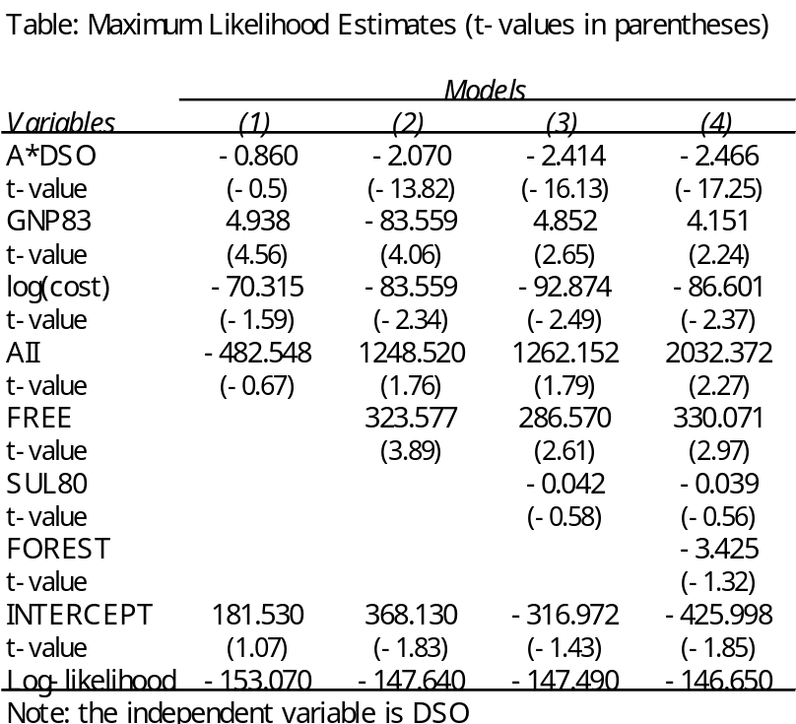
Statistical Results
Packaging charges are output taxes, and relate to the potential waste disposal and pollution impact.
From the consumer’s viewpoint, a product charge is an increase in the price of non-recyclable goods. If price of recyclable/reusable goods remains unchanged, this means that NRG will be substituted by RRG.
However, the effectiveness of the tax lies more on how it changes producer’s behavior ( product design ) than consumer’s behavior.
Moreover, as it relates to the potential pollution impact, to comply with environmental and economical effectiveness principles the tax should reflect the costs of pollution abatement and marginal damage of disposal.

Slide 40
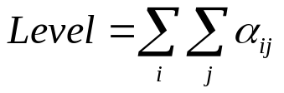
Concluding Remarks
Transboundary pollution problems are usually seen as public goods (or bads)
The problem is purely public when each nation’s emissions are summed to obtain the total amount of emissions, and the aggregated effect is experienced equally by each nation, that is, all nations receive the same level of public bad.
The associated transport matrix is an n× n matrix with 1’s in all entries.
Examples of this kind of problems are CO₂ emissions and depletion of the ozone layer.
When the effects of the emissions are divisible, the good (bad) is impure or quasi-public. Only a fraction of the total is felt by each nation, and the fractions sum to the total.
The transport matrix is an n× n matrix with elements α_{ij} not necessarily equal to α_{ji}, and
Sulfur oxide depositions belong to this kind of problem.
i = 1,2,3,…,n
Notes:
Focusing on urban solid waste, we find that it presents a couple of characteristics that set it apart from, lets say, industrial waste and waste coming from mining and agriculture.
The first characteristic is that agricultural, mining and industrial waste correspond to extractive and transformation activities, whereas urban solid waste is located further down in the production-consumption chain. As we go down the chain, the composition of waste becomes less and less homogeneous, resulting in an ill-characterized waste that poses difficulties to many material reuse plans and waste management operations.
The second characteristic is that sources of urban solid waste are not well identified since they are geographically dispersed. In this regard, study of the waste management process should include elements of geographical analysis.
The waste management process can be said to consist of the following steps: waste generation; handling, separation and processing at source; collection gathering and transport; separation, processing and transformation; transfer and transport; and disposal. After disposal, emissions result that inevitably have to be absorbed by the environment.
Information and knowledge about the process should help to take better and better informed decisions. From a planning point of view, waste generation, collection of waste, operation and capacity projections of facilities are of interest. Waste generation studies are located, in any case, at a primary level.

